Slide 1
714.549.4435
2991 Grace Lane Suite 2G
Costa Mesa CA 92626
NaturalHealingCenter.US

Slide 2
Shannon Eggleston
Naturopath, HHP

Slide 3
5 Approaches to Resolving Pain & Symptoms Naturally & Permanently
1. Alarm Points
2. Causes & Physical Side Effects of Stress
3. Roadblocks to Healing
4. The Truth About Scars
5. The Power of NOW

Slide 5
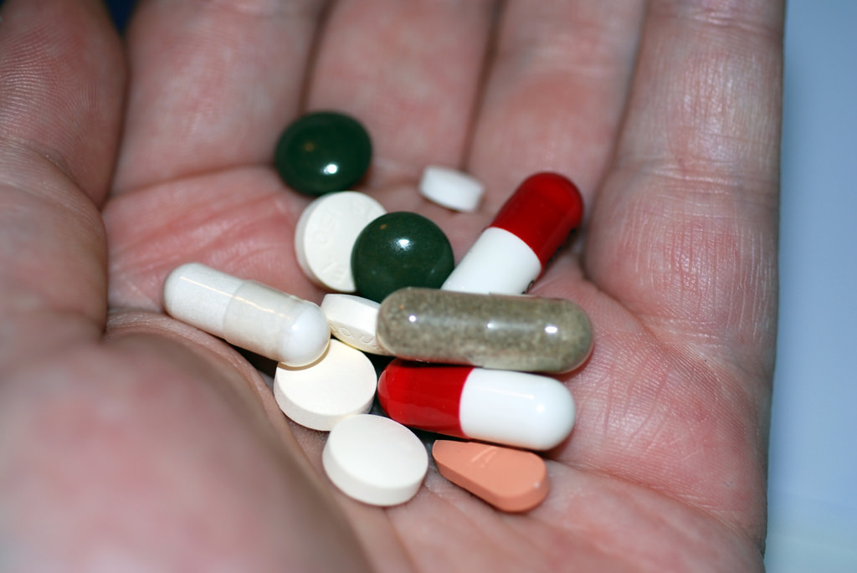
Did You Know?
60% of Americans (2 of 5 American Adults)
Start the day with a hot shower, a cup of coffee, and a handful of pills ( 4 on avg)

Slide 6
Opiod Epidemic
Between 26.4 and 36 million people abuse opioids worldwide
Estimated 2.1 million people in the U.S. suffer from substance use disorders related to prescription opioid pain relievers in 2012
Estimated 467,000 addicted to heroin
*National Institute on Drug Abuse

Slide 7
Avg. cost of one surgery Health Costs #1 Cause of Bankruptcy
STATE WIDE MEDIAN in Orange County (2014)
Thyroidectomy |  | $47,190
Gallbladder Removal (laparoscopic) |  | $44,678
Knee Replacement (total) |  | $85,497
Hip Replacement (total) |  | $88,497
CABG (Coronary Artery Bypass Graft) |  | $238,858
OHSPD 2014 Common Charges Hospitals Orange County CA

Slide 8
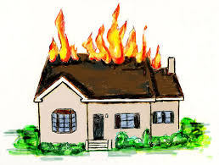
PAIN
Pain is NOT the problem – Pain is the Symptom!
Pain is a symptom of a problem

Slide 9
Know the Alarm Points

Slide 10
Stressors (Cause Pain)
Stress can be caused by
Scars
Food Sensitivities
Processed Foods
Synthetic Vitamins
Immune Challenges
Chemical Challenges
Metal Challenges
Electro Magnetic Fields (EMFs)

Slide 11
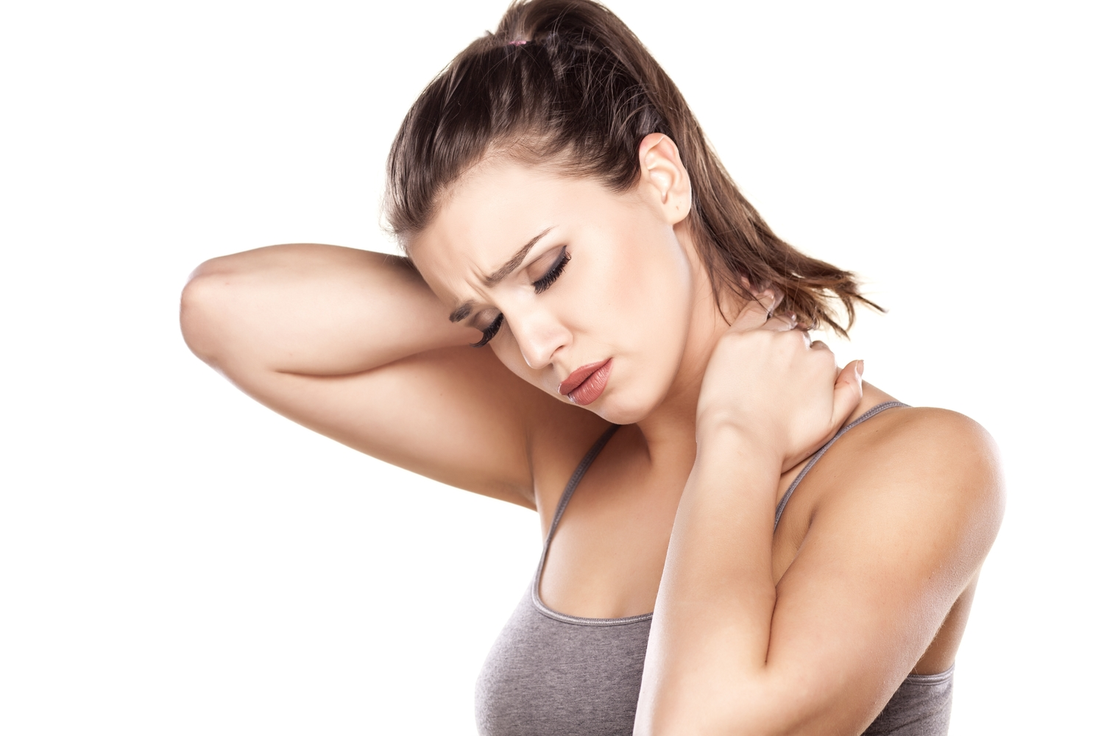
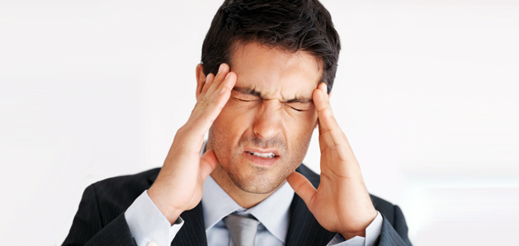
Physical Side Effects of Stressors (Symptoms)
PAIN
Fatigue
Arthritis
Bloating
Weight Gain
High Blood Pressure
Insomnia
Headaches and Migraines
IBS/IBD
Acid Reflux
Osteoporosis
Anxiety
Depression
Diabetes
Disease
And Many, Many others

Slide 12
Roadblocks to Healing

Slide 13
The Meridians – Your Freeway

Slide 14
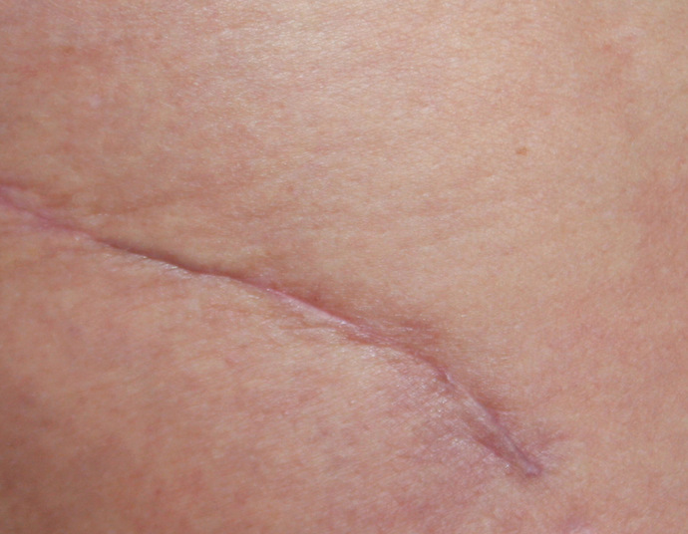
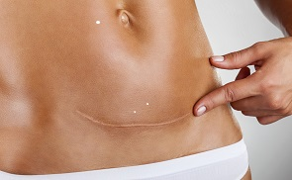
The Truth About Scars
Scars can make your heart race out of control…interrupt your sleeping…cause you to wake up many times in one night.…negatively impact your digestion…. sometimes they can even impair your hearing, vision or flexibility!
Scars can also throw a wrench in your progress for weight loss or necessary weight gain!

Slide 15
The Truth About Scars
Small scars (especially around the midline of the body) can have a weighty effect.
C-section, episiotomy, circumcision, vasectomy scars, and navel
Holes in the body can behave like scars
Pierced navels, nose rings, pierced ears, and tongue rings
Navel rings almost always have a wicked effect as they not only cross and disrupt the energy flow, but because they are metal, they can have an electromagnetic effect.
Tattoos, stretch marks, and burns can also have this effect.

Slide 16
Rub Your Scars
Rub scars gently and slowly with: organic wheat germ oil, organic sesame oil or organic black currant seed oil
2 times a day, four minutes each
If your scar is horizontal, rub vertically.
If your scar is vertical, rub horizontally.
If the scar is a circle, rub around and back & forth.

Slide 17
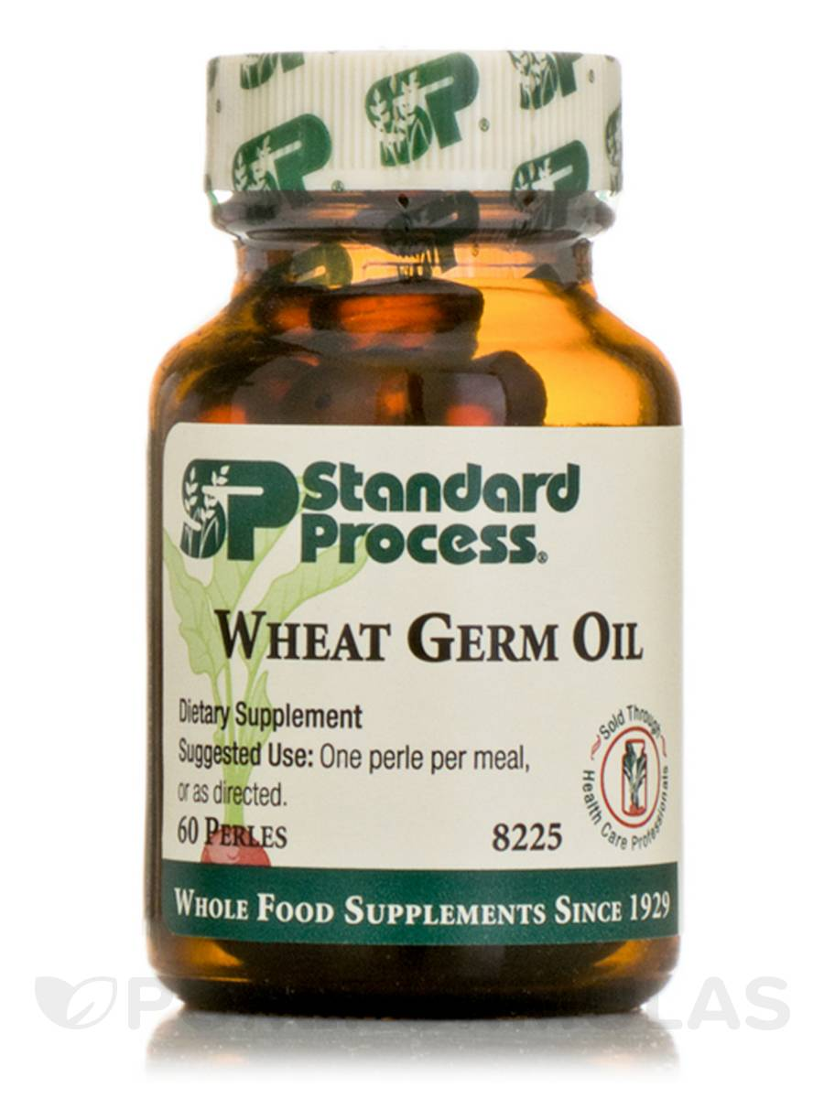
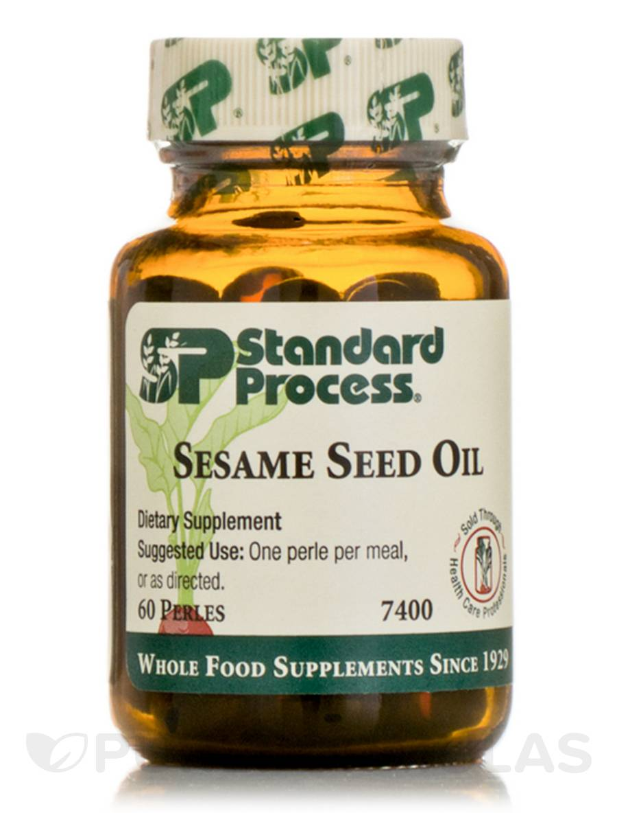
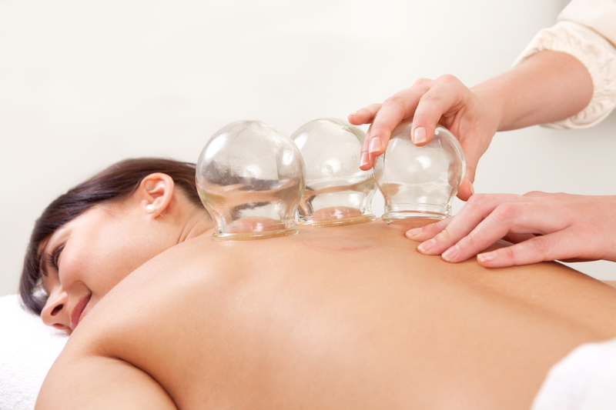
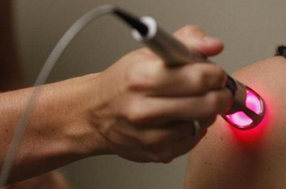
Additional Treatments for Scars
High Quality Oils
Chinese Cupping
Cold Laser Therapy

Slide 18
The Power of NOW
Nutrition
Oxygen
Water

Slide 19
Nutrition
Protein: Chicken, Beef, Fish, Lamb
Organic Veggies: Green Leafy Veggies, Asparagus, Broccoli, Brussel Sprouts
Complex Carbs: Yams, Zucchini, Squash, Pumpkin
Good Fats: Avocado, Olive Oil, Raw Nuts, Chia Seeds, Flax Seeds

Slide 20
Digestion
Avoid all stressors
Adrenal stress stops stomach acid from forming; leaving digestion null and void
Body can’t break down foods for nutritional needs
Fats cannot be broken down causing gallbladder issues and loss of taste for meat (can’t break down meat)
Can progress to not being able to break down anything but steamed vegetables
Can cause a sugar addiction and loss of all nutrition

Slide 21
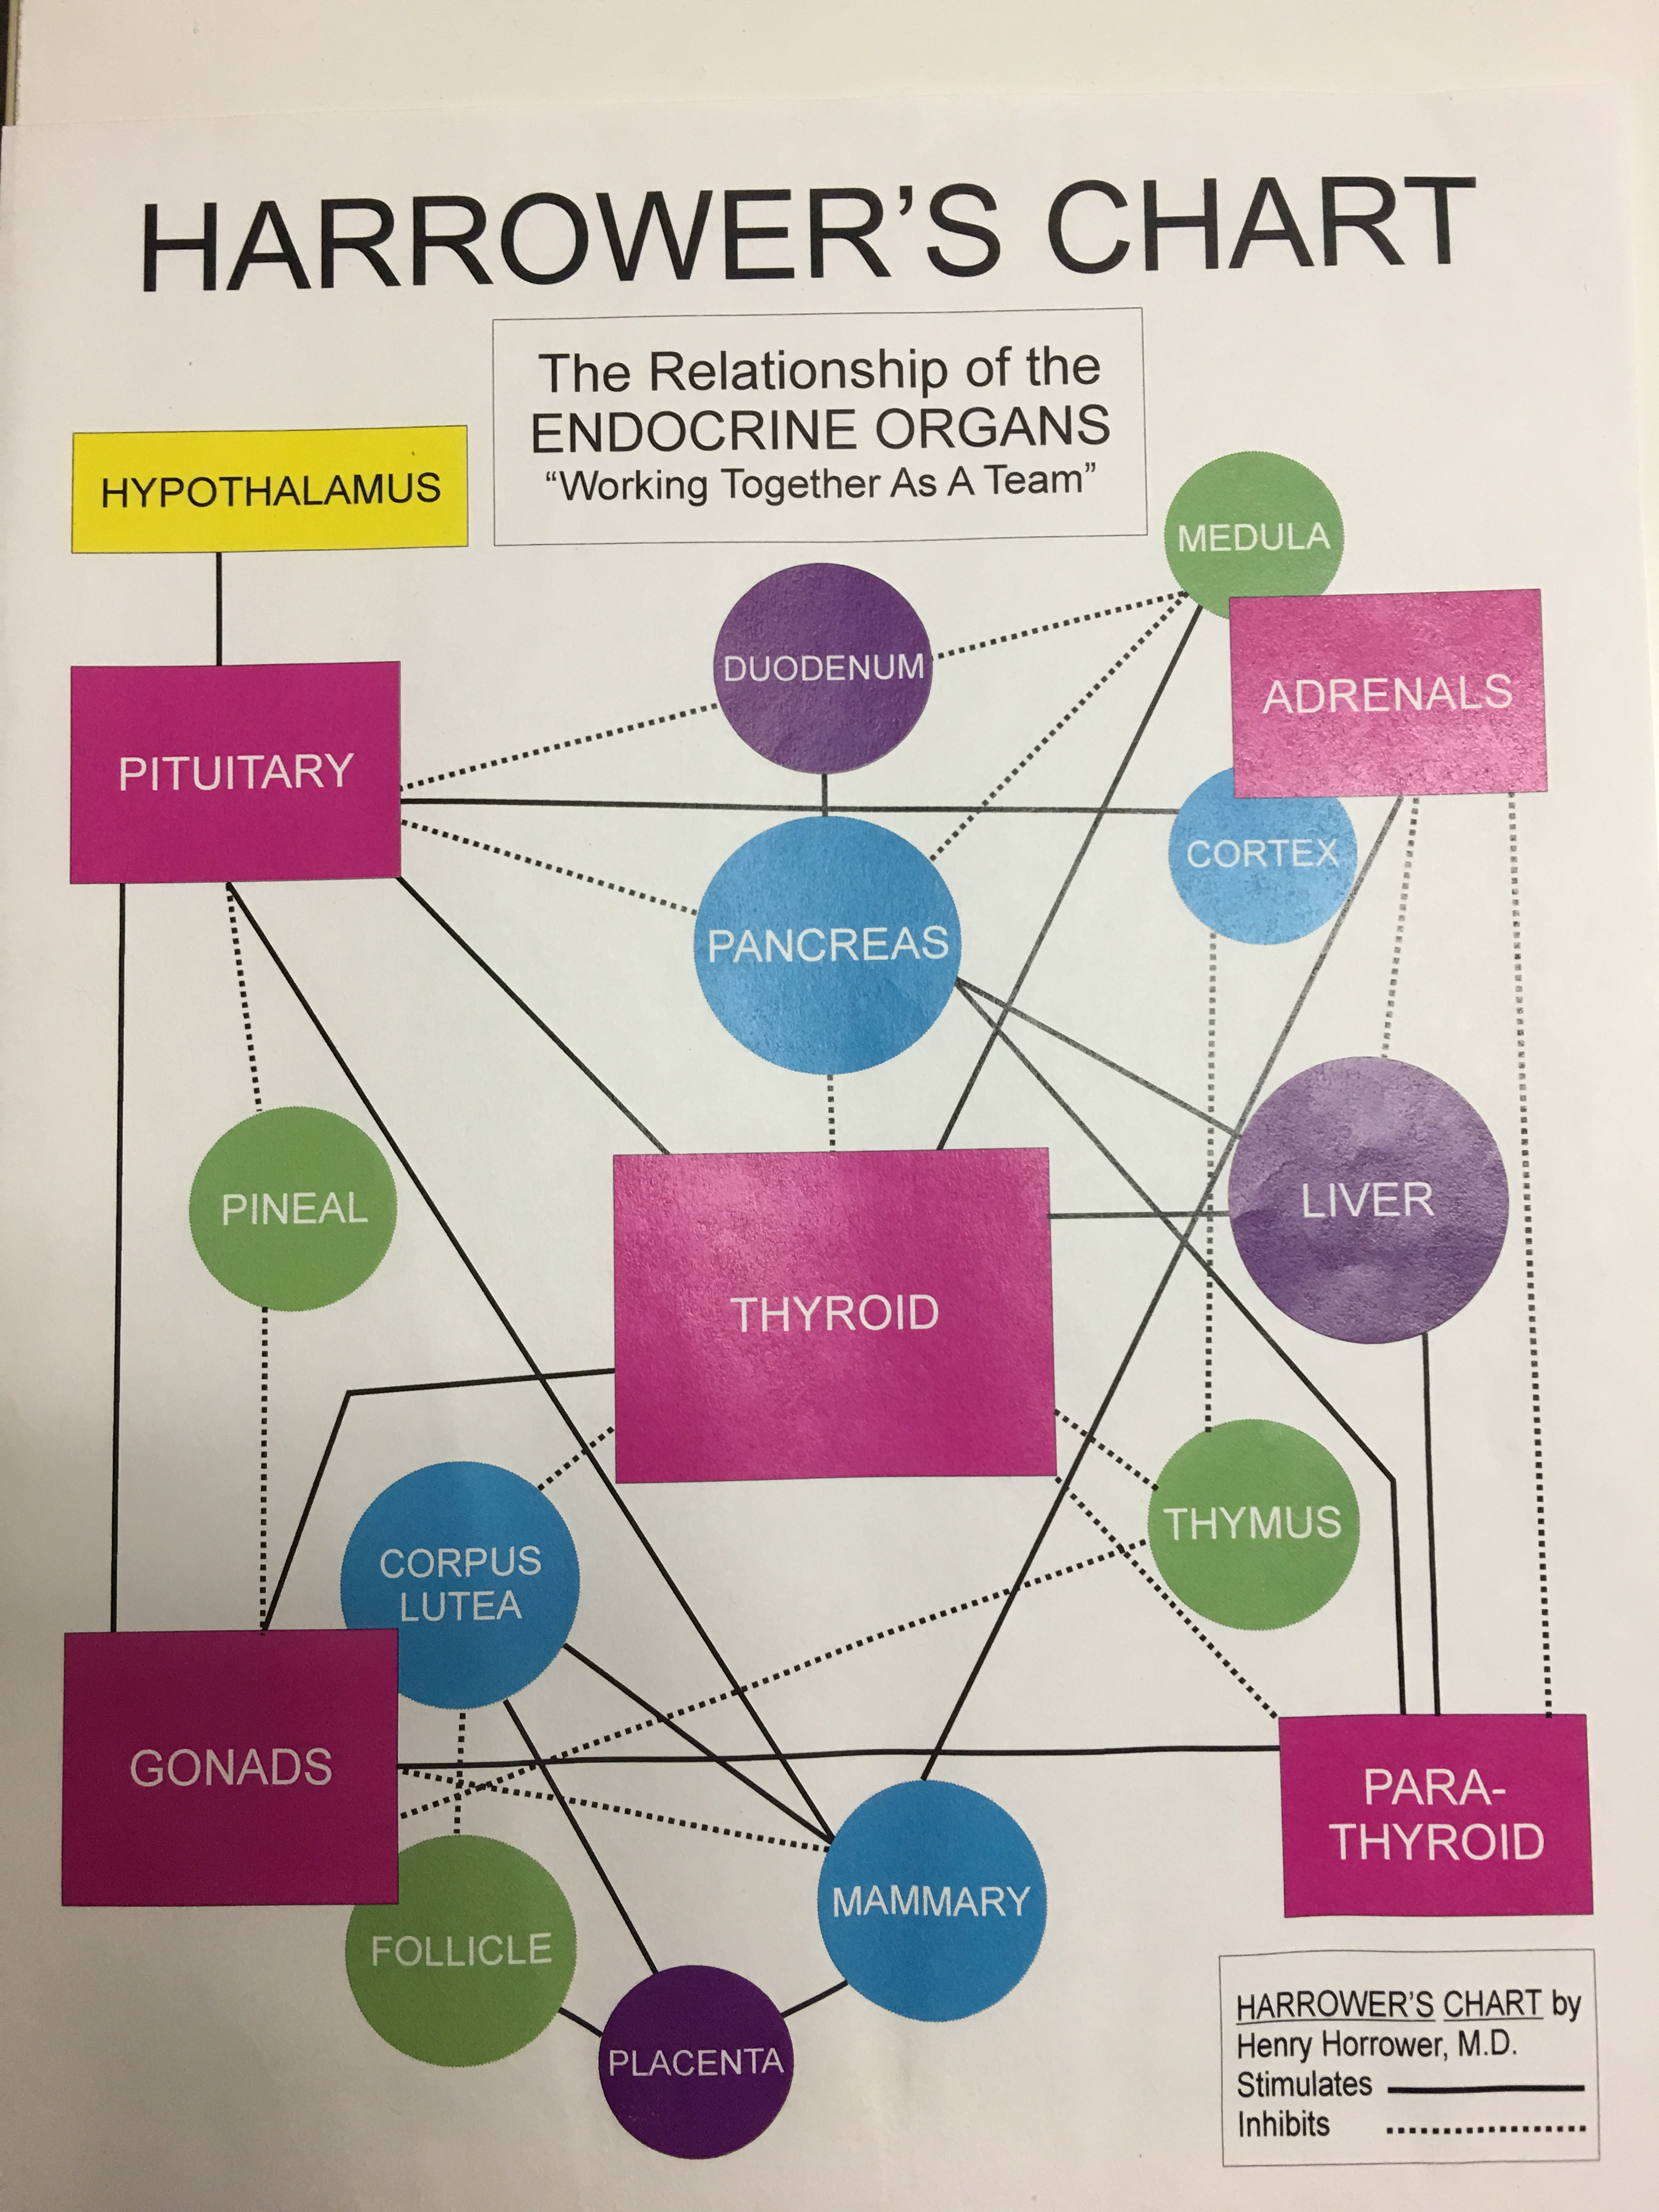
Harrower’s Chart

Slide 22
Relaxation
Minimum 8 Hours of sleep per night
Avoid Arguing
Forgive
Receive…….
How do YOU destress/unwind?

Slide 23
Brain Health

Slide 24
EPA & DHA
Did you know that EPA +DHA can reduce risk of coronary events by 53%?
Sudden death from heart attack by 90%?
Improve cognition and mental health with aging, reduce depression, reduce the risk of dementia, Alzheimer’s and stroke?
And in children, improve verbal and motor skills?
Did you know that an average American consumes a tiny 100-200mg of EPA + DHA where the National Institutes of Health’s minimum recommendation is 5x that at 650 mg/day?

Slide 25
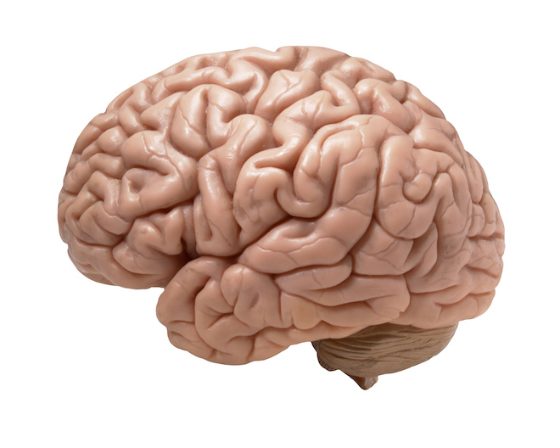
Specific Fatty Acids are Critical to a Healthy Nervous System
EPA & DHA
Reduce Inflammation
Repair Nerve Cells
Regulate Cell-to-Cell Signaling
Improve Mood, Memory & Focus
Improve Immune Function
Reduce Nerve & Joint Pain

Slide 26
Oxygen
Practice Breathing
for
Relaxation and Pain Control

Slide 27
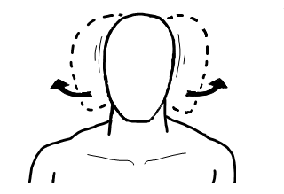
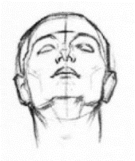
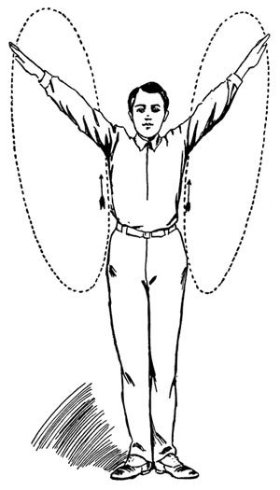
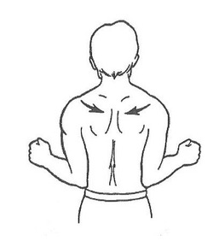
The Eggleston Maneuver
Inhale then Exhale as you Perform the Stretch
1. Neck rotation with head on flat pillow
(head tilted back)
2. Arm rotation backwards in your range of motion
3. Shoulder pinches backwards while exhaling

Slide 28
Drink Half your Body Weight in Ounces

Slide 29
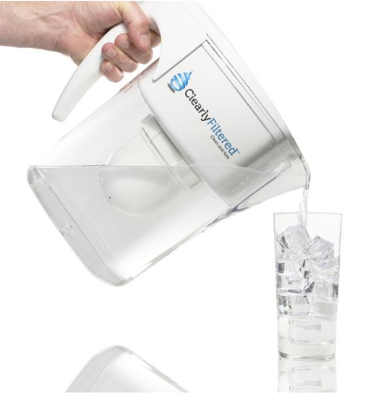
Drink Pure Spring Water
Filter your Water to Remove Common Toxins:
Fluoride
Chlorine
Lead
Mercury
Chromium 6
Arsenic
Pesticides
Insecticides
Chemicals
And More

Slide 30
Questions?

