Slide 1
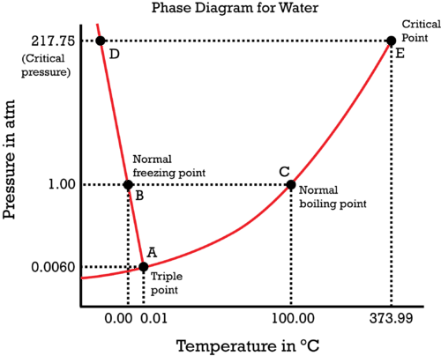
Typical “heat to boil” transition
Solid
Liquid
Gas
Boil by
lowering pressure

