Slide 1
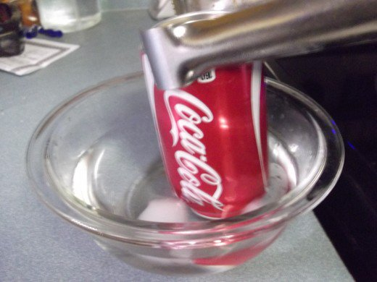
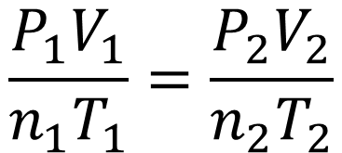
$$PV=nRT$$
$$\frac{P_{1}V_{1}}{n_{1}T_{1}}=\frac{P_{2}V_{2}}{n_{2}T_{2}}$$

