Slide 1
Discussion Questions:
Why are the anode and cathode different colors?
Why is sodium sulfate basic?
Is the sodium sulfate being hydrolyzed?
What do you notice about the volume of the gases being created?
Which gas is O₂? Which is H₂? How do you know?

Slide 2
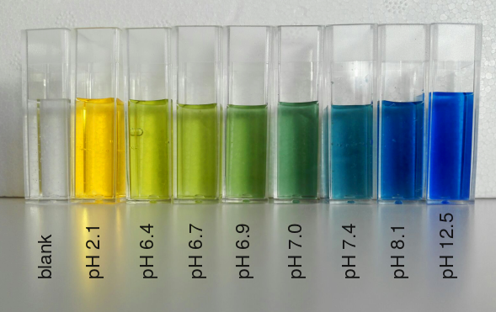
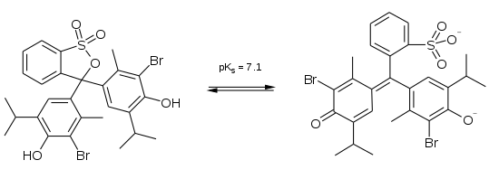
Bromothymol Blue
Sodium Sulfate
$${Na}_{2}{SO}_{4}→Na^{+}+{SO}_{4}^{2−}$$
Sodium Sulfate is a basic salt

Slide 3
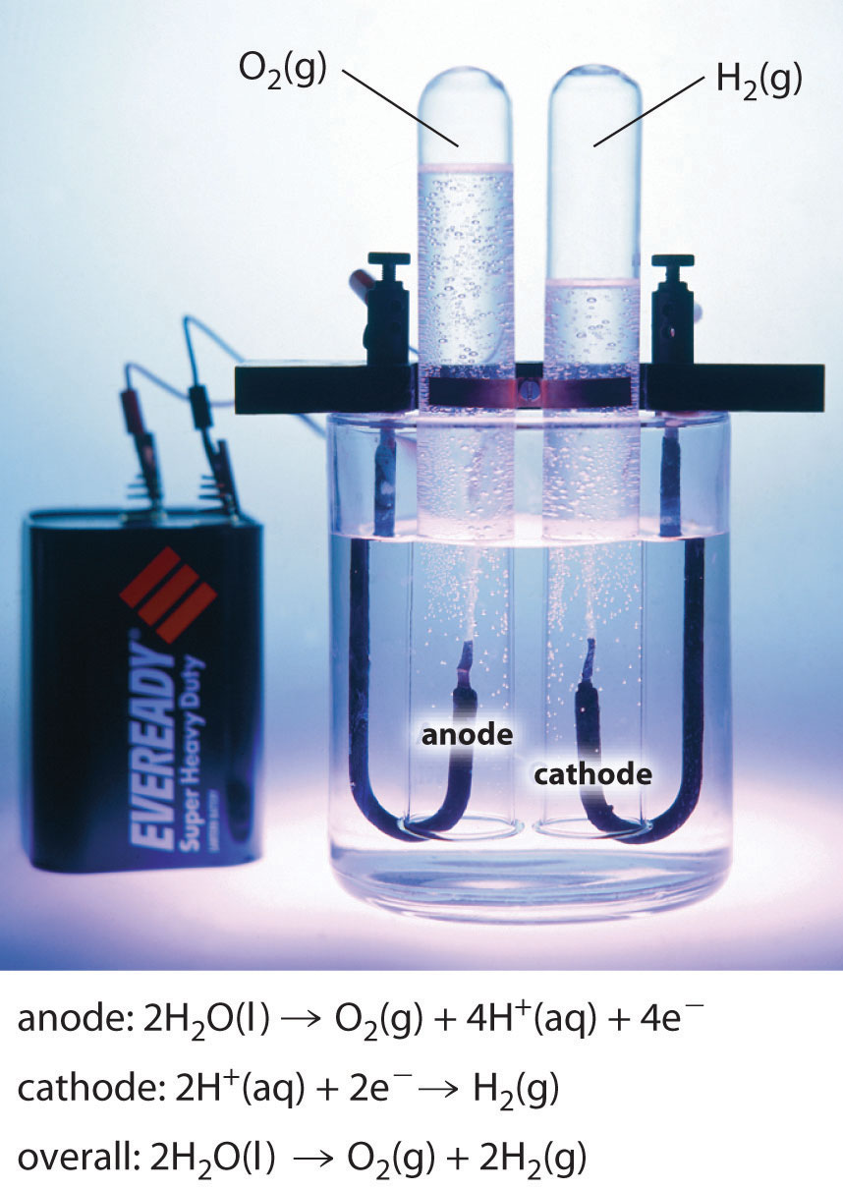
At the anode H+ is a product.
At the cathode H+ is a reactant.

Slide 4
Discussion Questions:
What do you notice about the volume of the gases being created?
Which gas is O₂? Which is H₂? How do you know?

