Slide 1
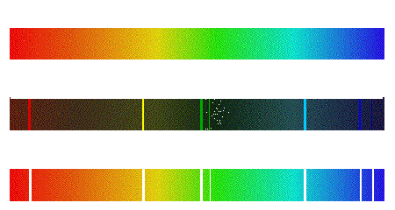
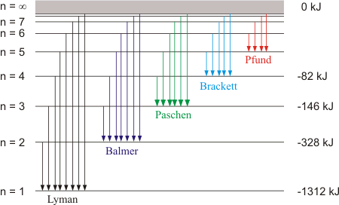
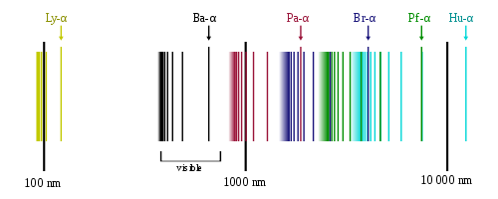
Emission Series: hydrogen

Slide 2
Lithium emission spectrum
Potassium emission spectrum
Sodium emission spectrum
Calcium emission spectrum
Copper emission spectrum

Slide 3
